Slide 1









Microbial Hazards Risk Ranking
1
MiRA

Slide 2
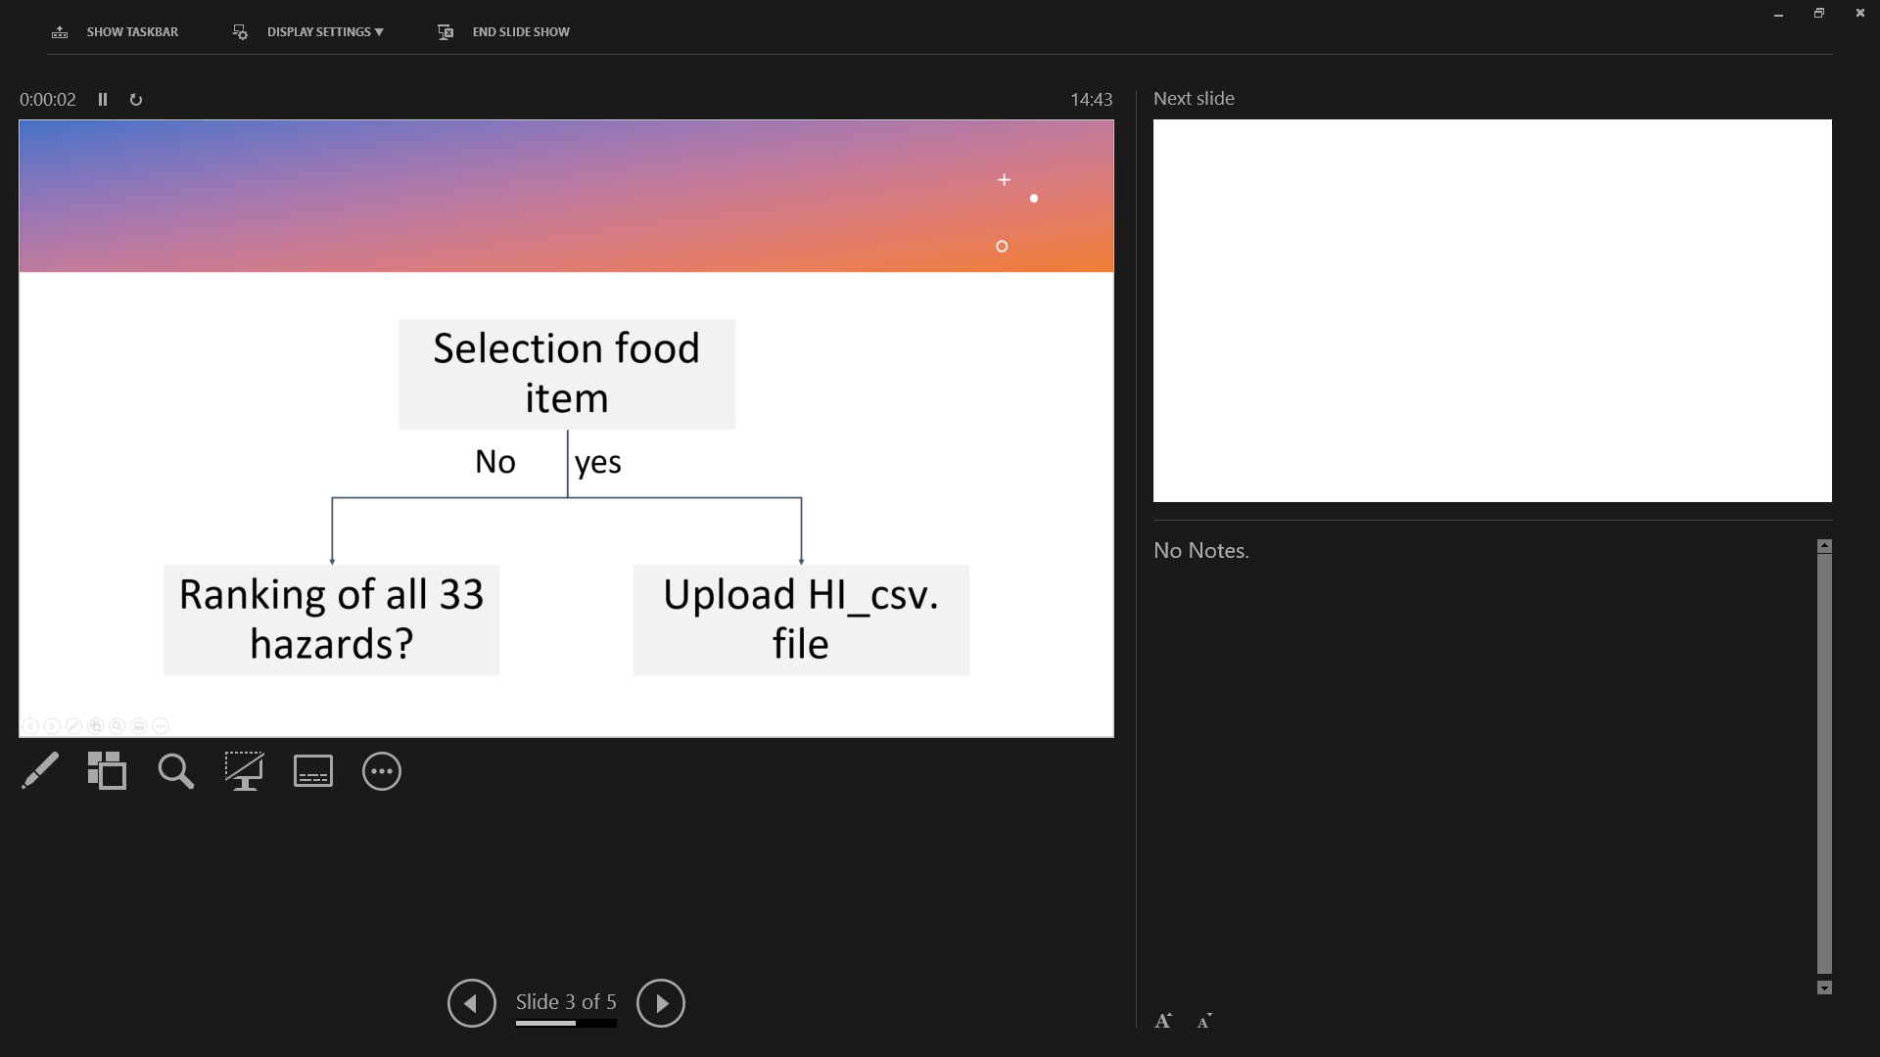


Microbial Hazards Risk Ranking Criteria
Microbial Hazards Risk Ranking Criteria
User’s input
Default data input
Severity
Likelihood
DALY/case (HS)
(C8)
Hazard-Food Characteristics
(HFC)
Hazard-Food Association
(HFA)
Food Consumption (FC) (C7)
Processing survival (C2)
Recontamination (C3)
Post-processing control (C4)
🠚 IF: growth opportunity
🠚 EF: storage/distribution/retail
Meal preparation (C5)
Outbreak prevalence (C6A)
Food contamination prevalence (C6B)
Sampling prevalence (C6C)

Slide 3
Grouping of Risk Ranking Criteria
User’s input
Default data
Parameter | Criteria
Food | item Composition Acidity
Factory | C1 Processing survival C2 Recontamination
Distribution | C3 PPE: growth opportunity C4 PPE: storage, distribution and retail C5 Meal preparation
Others | Include hazard with no/low evidence
Parameter | Criteria
C6 Prevalence Outbreak Contamination Sampling | Default value is automatically added into the calculation
C7 Food consumption
C8 Severity

Slide 4
Food parameter: Select food item
User’s input
Mira
Selection food item
Selection food item
shows hierarchy & code on FoodEx2 next to food item
Ranking of all 33 hazards?
Ranking of all 33 hazards?
No
yes
No
yes
Default way
Upload HI_csv. file
No action is needed
Upload HI_csv. file
No action is needed
Provide link to MiID
https://foodmicrobiologywur.shinyapps.io/Microbial_hazards_ID/

Slide 5
Food parameter: select food composition
User’s input
Mira
Food composition
Food composition
Factors | Tick relevant
High fat | □ yes
Low Aw (0.5-0.9) | □ yes
Dry product (aw < 0.5) | □ yes
pH < 4.5 | □ yes
4.5 < pH < 4.8 | □ yes
pH > 10 | □ yes
Neutral | □ yes
This step influences the inactivation efficacy of the selected processing techniques in the next input
Check processing techniques of factory parameter
Take the corresponding value

Slide 6
Decision tree
Risk value | Score
1E-20 | 1
1E-18 | 1
1E-12 | 1
1E-10 | 2
1E-8 | 2
1E-6 | 2
1E-5 | 2
1E-4 | 3
1E-3 | 3
1E-1 | 4
1 | 4
Processing inactivation effect
Select the processing techniques
Table 1
Thermal
None
High risk
Hazard group | No inactivation
Vegetative bacteria | 1
Virus | 1
Vegetative parasites | 1
Parasite cysts | 1
Heat-resistant virus | 1
Bacterial spores | 1
Bacterial toxin | 1
HPP
Pasteurize
Table 1
PCD
Boil
Select food composition
RF
Sterilize
Table 2
Dry food
High fat
No
Hazard group | Pasteurization | Boiling | Sterilization
Vegetative bacteria | 1E-6 | 1E-10 | 1E-20
Virus | 1E-6 | 1E-10 | 1E-20
Vegetative parasites | 1E-6 | 1E-10 | 1E-20
Parasite cysts | 1E-05 | 1E-10 | 1E-20
Heat-resistant virus | 1E-03 | 1E-10 | 1E-20
Bacterial spores | 1 | 1E-03 | 1E-12
Bacterial toxin | 1 | 1E-03 | 1E-12
Low risk
*exception rule
low risk for Campylobacter in dry foods
Table 2
yes
Medium risk
Table 3
Table 3
Hazard group | Pasteurization | Boiling | Sterilization
Vegetative bacteria | 1E-4 | 1E-8 | 1E-18
Virus | 1E-4 | 1E-8 | 1E-18
Vegetative parasites | 1E-4 | 1E-8 | 1E-18
Parasite cysts | 1E-3 | 1E-8 | 1E-18
Heat-resistant virus | 1E-1 | 1E-8 | 1E-18
Bacterial spores | 1 | 1E-1 | 1E-10
Bacterial toxin | 1 | 1E-1 | 1E-10

Slide 7
Factory parameter: processing techniques
User’s input
Mira
Techniques
Techniques + food composition
Thermal inactivation
Step 2_PE: relevant values in column H, I, or J is used. Display information on columns K &L based on the factory parameter selection
Factors | Tick relevant
High fat | □ yes
Low Aw (0.5-0.9) | □ yes
Dry product (aw < 0.5) | □ yes
pH < 4.5 | □ yes
4.5 < pH < 4.8 | □ yes
pH > 10 | □ yes
Neutral | □ yes
Pasteurizaiton
Boiling
Sterilization
When more than 1 factor is relevant, select the highest value

Slide 8
Default | Wet neutral product | Column H
Factors | Tick relevant | Data column
High fat | □ yes | Column I, display column K
Low Aw (0.5-0.9) | □ yes | Column J, display column L
Dry product (aw < 0.5) | □ yes | Column J, display column L
Acidity | Tick relevant | Data column
pH < 4.5 | □ yes
4.5 < pH < 4.8 | □ yes
pH > 10 | □ yes
Neutral | □ yes | Column H
Problem:
e.g., high fat AND dry;
Addition: has no meaning
Multiplication: make the value smaller which does not make sense
Solution:
When more than 1 factor is relevant, select the highest value

Slide 9
Factory parameter: Recontamination
User’s input
Mira
Sources | Tick relevant
Aseptic processing | □ yes
Wet environment | □ yes
Dry environment | □ yes
Addition of dry herbs or spices | □ yes
Addition of dry vitamins | □ yes
Addition of other dry ingredients | □ yes
Human cross-contamination | □ yes
Sources | Tick relevant
Aseptic processing | □ yes
Wet environment | □ yes
Dry environment | □ yes
Addition of dry herbs or spices | □ yes
Addition of dry vitamins | □ yes
Addition of other dry ingredients | □ yes
Human cross-contamination | □ yes
Step 3_RP: pick the relevant columns and add the numerical values assigned for EF & RF

Slide 10
Decision tree
Category of dry ingredients | Risk of recontamination for relevant hazard
dry spices | 0.5
other dry ingredients | 0.05
dry vitamins | 0.005
Risk value | Score
1E-6 | 1
0.005 | 2
0.05 | 3
0.5 | 4
0 | 0
Recontamination =
R _{environmental factor +} R _{food handling}
Food handling
Yes
No risk and no addition of other ingredients
Processing in close bag?
0
No
*Zero here indicates the entire branch of recontamination will be excluded from RR instead of multiplying with the value zero
Environmental factor
Addition of unprocessed ingredients?
Include possible environmental contaminants?
No
Yes
No
Yes
Dry/Wet?
Human contact with food?
Dry/Wet?
No
Yes
Yes
None/very low risk
Minor risk with MH- dry/wet environment
None/very low risk
Minor risk with MH- humans
Major risk with MH- dry/wet ingredients
*Assuming 50% of 100% of unprocessed ingredients may be contaminated
X
1E-6
0.001
1E-6
0.001
0.005
Category of dry ingredients | Risk of recontamination for relevant hazard
dry spices | 0.5
others | 0.05
dry vitamins | 0.005

Slide 11
Recontamination scenario comparision
 | Assign risk values
Aseptic processing | 0
Environment factor: |  | None | vitamin or human | dry ingre | spices | addition of all dry options | addition of all dry options + human contamination
Wet environment | 1E-6 OR 0.005 | 1.00E-06 | 0.005
Dry environment
Addition of dry herbs or spices | 1E-6 OR 0.005 OR 0.05 or 0.5 | 1.00E-06 | 0.005 | 0.05 | 0.5
Addition of dry vitamins
Addition of other dry ingredients
Human cross-contamination
 | Calculated risk | 1.00E-12 | 5.00E-09 | 5.00E-08 | 5.00E-07 | 1.25E-10 | 6.25E-13
 |  |  |  |  |  | 3.34E-03 | 3.62E-03 | root function
Problem:
Selection of more options for recontamination category ➔ lower value due to multiplication
Solution:
Replace with addition, and it reflects more to the reality

Slide 12
Recontamination scenario comparision
 | Assign risk values
Aseptic processing | 0
Environment factor: |  | None | vitamin or human | dry ingre | spices | addition of all dry options | addition of all dry options + human contamination
Wet environment | 1E-6 OR 0.005 | 1.00E-06 | 0.005
Dry environment
Addition of dry herbs or spices | 1E-6 OR 0.005 OR 0.05 or 0.5 | 1.00E-06 | 0.005 | 0.05 | 0.5
Addition of dry vitamins
Addition of other dry ingredients
Human cross-contamination
 | Calculated risk | 1.00E-12 | 5.00E-09 | 5.00E-08 | 5.00E-07 | 1.25E-10 | 6.25E-13
 |  |  |  |  |  | 3.34E-03 | 3.62E-03 | root function
Problem:
Scenario 1: “ 0 “ in the RP category
Scenerio 2: “ 0.005” in the RP category
Final RR: Scenario 1 should be < Scenario 2
But it is the opposite for now.
Solution: addition will solve the problem

Slide 13
Recontamination scenario comparision
 | Assign risk values
Aseptic processing | 0
Environment factor: |  | None | vitamin or human | dry ingre | spices | addition of all dry options | addition of all dry options + human contamination
Wet environment | 1E-6 OR 0.005 | 1.00E-06 | 0.005
Dry environment
Addition of dry herbs or spices | 1E-6 OR 0.005 OR 0.05 or 0.5 | 1.00E-06 | 0.005 | 0.05 | 0.5
Addition of dry vitamins
Addition of other dry ingredients
Human cross-contamination
 | Calculated risk | 2.00E-06 | 5.00E-03 | 5.00E-02 | 5.00E-01 | 5.55E-01 | 5.60E-01
Scenario 1: “ 0 “ in the RP category
Scenerio 2: “ 0.005” in the RP category
Mutiplication:
Scenario 1: “0”* 5
Scenario 2: 0.005 * 5
Addition:
Scenario 1: 0+5 = 5
Scenario 2: 0.005+5 = 5.0005

Slide 14
Distribution parameter – storage/distribute/retail
User’s input
Mira
Storage/distribution/retail | Tick relevant
Room temperature | □ yes
Refrigeration | □ yes
Frozen | □ yes
Potential temperature abuse | □ yes
Storage/distribution/retail | Tick relevant | Food composition filled by user | Cardinal parameter
Room temperature | □ yes | Take data in food parameter | Compare with cardinal parameter in Supplementary Table X, & take the estimated likelihood in step 4_ PPC2
Refrigeration | □ yes
Frozen | □ yes
Potential temperature abuse | □ yes

Slide 15
Decision tree
Risk value | Score
1E-6 | 1
1E-3 | 2
1 | 3
Post-processing control
Growth Opportunity
No
Hazard needs growth in food to cause illness?
yes
Food characteristic ?
pH <4.5 or >4.5
Dry/half dry/wet
Food characteristics support hazard growth?
No
*Only yes/no growth in food characteristics is taken into consideration, with exceptions for some strains that can otherwise grow in the conditions they cannot grow are
are not taken into consideration
yes
Storage/distribution/retailing conditions
RT
Cold
1-4°C
Freeze
0°C
Potential temperature abuse?
High risk
medium risk
low risk
1
1.00E-03
1.00E-06

Slide 16
Distribution parameter – Meal preparation
User’s input
Mira
Step 5_MP: pick the value in the relevant columns E, F or G
Meal preparation | Tick relevant
Ready to eat | □ yes
Ready to heat <70°C | □ yes
Ready to cook > 70°C | □ yes
Hazard group | RTE | RTH <70°C | RTC >70°C
Vegetative bacteria | 1 | 1E-2 | 1E-4
Virus | 1 | 1E-2 | 1E-4
Vegetative parasites | 1 | 1E-2 | 1E-4
Parasite cysts | 1 | 1E-1 | 1E-03
Heat-resistant virus | 1 | 1 | 1E-02
Bacterial spores | 1 | 1 | 1
Bacterial toxin | 1 | 1 | 1

Slide 17
Decision tree
Risk value | Score
1E-4 | 1
1E-3 | 1
1E-2 | 2
1E-1 | 3
1 | 4
Effect of meal preparation
Further cooking/prep process involved?
Ready to eat foods
Thermal Cooking > 70°C
High risk
Medium risk
low risk
Table 4
1
Table 4
Table 4
Hazard group | Cooking <70C | Cooking >70C
Vegetative bacteria | 1E-2 | 1E-4
Virus | 1E-2 | 1E-4
Vegetative parasites | 1E-2 | 1E-4
Parasite cysts | 1E-1 | 1E-03
Heat-resistant virus | 1 | 1E-02
Bacterial spores | 1 | 1
Bacterial toxin | 1 | 1
* Meal preparation ELIMINATES no hazards

Slide 18
Prevalence and Severity data
User’s input
Mira
Based on user’s input in step 1, display the respective data column in Step 6_HFA4th root, Step 7_FC and Step8_HS values
Parameter | Criteria
Food | item Composition Acidity
Show total ranking of results in a Table
Show total ranking of results in a plot

Slide 19
Decision tree
Hazard Prevalence
Food Consumption
Consumption % by Infants/toddlers in EU ?
Contamination alerts
(US & EU)
Outbreak
(US & EU)
Sampling
(meta-analysis)
Actual consumption percentage in the population of infants and toddlers up to the age of 3 in EU (%)
NR
Strength of evidence (%)
*Assuming 1/million chance it may be the exception
1E-6
Prevalence percentage | Risk value | Score
NR | 0.000001 | 1
< 1% | <0.01 | 2
1-10% | 0.011-0.1 | 3
10.1 - 40% | 0.101 - 0.4 | 4
> 40% | > 0.4 | 5
Consumption percentage | Risk value | Score
NR | 0.000001 | 1
< 1% | <0.01 | 2
1-10% | 0.011-0.1 | 3
10.1 - 40% | 0.101- 0.4 | 4
> 40% | > 0.4 | 5

Slide 20
Decision tree
Risk value (DALY/case) | Score
< 0.05 | 1
0.05-0.5 | 2
0.51-5 | 3
> 5 | 4
Hazard severity
DALY reported?
DALY/case <0.05
Low impact hazard
Low-risk and usually self-limiting
DALY/case = 0.05- 0.5
Minor impact hazard
Minor risk and may require medical treatment
Other data available for calculation?
DALY/case = 0.51-5
Severe impact hazard
Medium risk and mainly require medical treatment
Assumption based on closely-related species that have similar sequelae
High risk and causes severe illness/death to victims
DALY/case > 5
Critical impact hazard

Slide 21
Parameter set up in MCDA PROMETHEE
Table 6: Parameters used to run PROMETHEE II on R Software
Parameters | C2+3 | C4 | C5 | C6 | C7 | C8 |  | Justification
Indifference | 0 | 0 | 0 | 0 | 0 | 0 |  | The indifference threshold is zero as the criteria values are considered as real numbers (without uncertainty).
Preference | 2.5e-5ª | 1^{b} | 1^{c} | 0.056^{b} | 0.47^{c} | 8.47^{b} |  | The preference threshold reflects where a difference between 2 scores makes a real added value in the decision. The first choice was the difference between the 75th and 25th percentiles. However when this difference equaled zero, the second choice was to increase this percentile range and if still zero, to take the maximum value
Type of preference | “V-shape” | “V-shape | “V-shape | “V-shape | “V-shape” | “V-shape” |  | “V-shape” to generate a proportional preference
Weight | 1/6 | 1/6 | 1/6 | 1/6 | 1/6 | 1/6 |  | We assume that the 7 criteria had the same weight on the final risk
a: difference between the 75th and 25th percentiles
b: the difference between the penultimate and the second percentiles
c: the maximum value

Slide 22
Final ranking of Microbiological hazards
Criteria input
Ranking output
Table 4: Risk ranking Criteria and Parameter.
Criteria (C) | Description | Parameter
C1ª | Food item | Food
 | Food composition
C2 | Processing survival | Factory
C3^{b} | Recontamination
C4 | PPE: growth opportunity | Distribution
 | PPE: storage, distribution, and retail
C5 | Meal preparation
C6^{n} | Outbreak | Prevalence
 | Food contamination
 | Samplingª
C7 | Food consumption of infants and toddlers | Consumption
C8 | DALY/case per hazard | Severity
Optional | Include hazard with no/low evidence | Others
Total Risk = (C2 + C3^{b})* C4* C5* (C6n)*^{1/n} *C7* C8
ª-excluded in ranking; ^{b}- addition of risk values. ^{n} = 4. Outbreak and food recall data in the EU and USA

